Slide 1
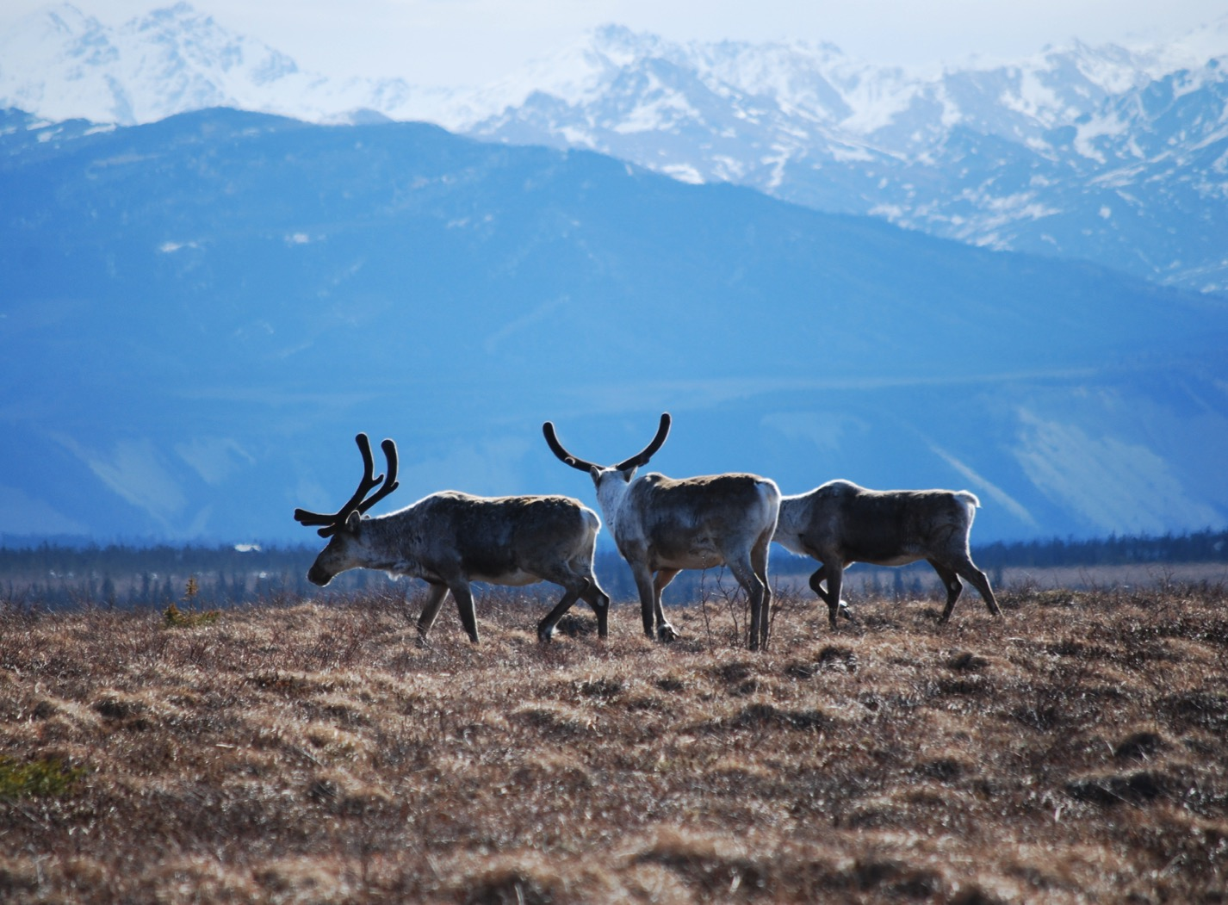
Arctic Boreal Vulnerability Experiment (ABoVE)
2017 ABoVE Airborne Campaign
19 July 2017 (DOY 200)
CFIS: Fort Smith – Saskatoon
Charles Miller, Deputy Science Lead
Jet Propulsion Laboratory, California Institute of Technology
and the ABoVE Science Team For Hank Margolis, Eric Kasichke, Bruce Tagg
NASA HQ
2017

Slide 2
19 July 2017/DOY 200 Fort Smith – Fort McMurray – Saskatoon
Daily Status:
CFIS / Twin Otter International N331AR
REPORT DATE: 19 July 2017
Current Status of Aircraft: GREEN
Current Status of CFIS: GREEN
Current Deployment Location: Saskatoon SK (CYFS)
Crew: xxx, xxx, Drewry, Pavlick
Science Lead: D Drewry

Slide 3
19 July 2017/DOY 200 Fort Smith – Fort McMurray – Saskatoon
Daily Summary:
Data acquired south of Fort Smith
Clear sky conditions
Transit to Saskatoon SK
Increasing clouds to the south prevented significant data acquisition during transit

Slide 4
19 July 2017/DOY 200 72-Hour Look Ahead
All plans weather dependent
Thursday 20 July 2017 (DOY 201):
BERMS/BOREAS area flux towers
Friday 21 July 2017 (DOY 202):
BERMS/BOREAS area flux towers
Saturday 22 July 2017 (DOY 203):
BERMS/BOREAS area flux towers

Slide 5
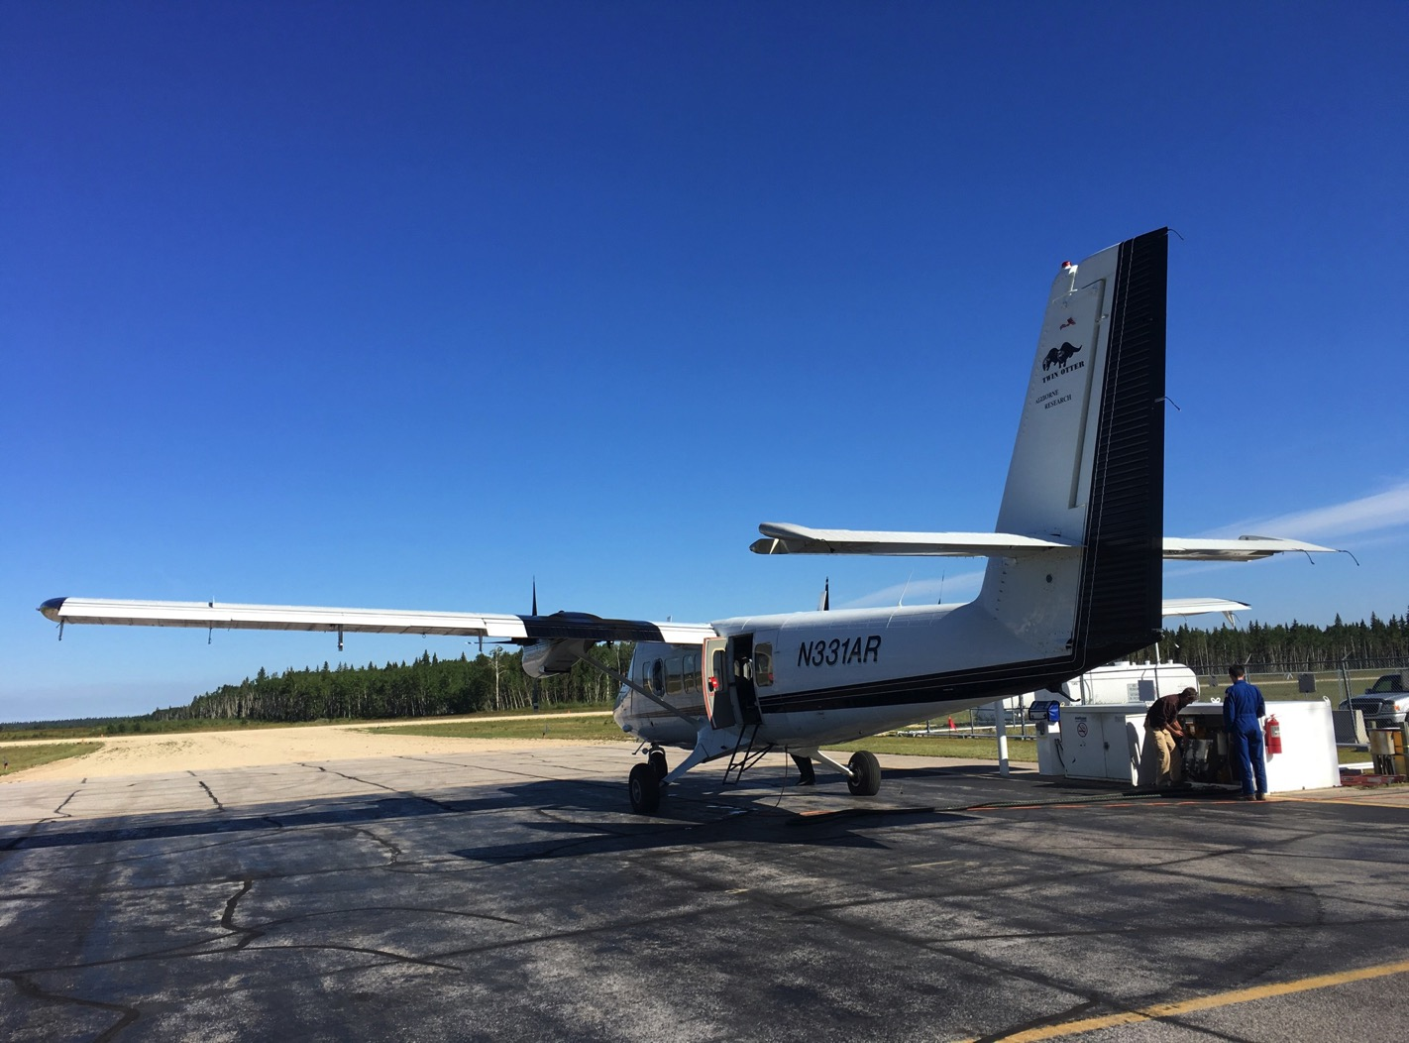
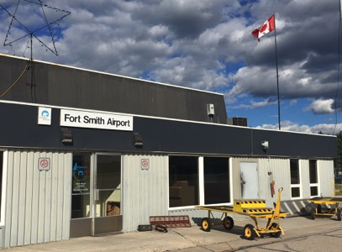
14 July 2017/DOY 195 Fairbanks – Inuvik
Another Perfect Day for CFIS Flying
Fort Smith NT

Slide 6
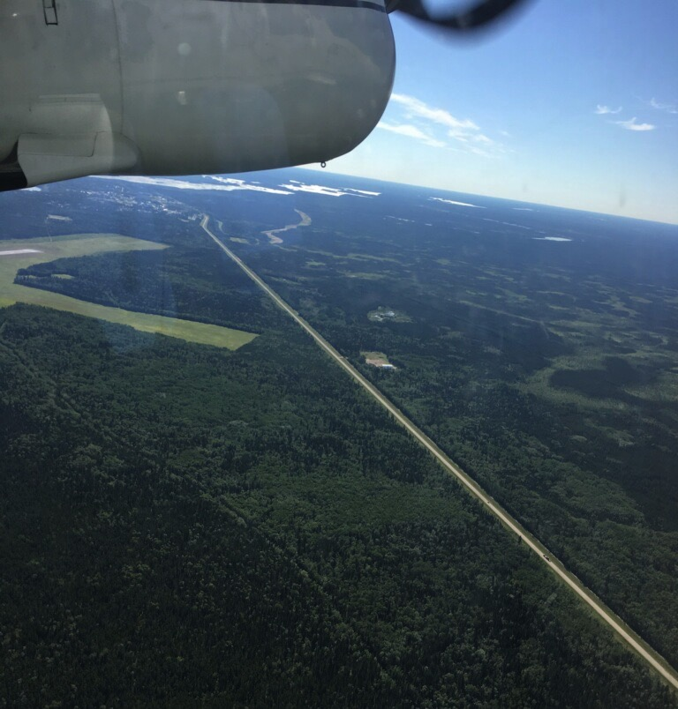
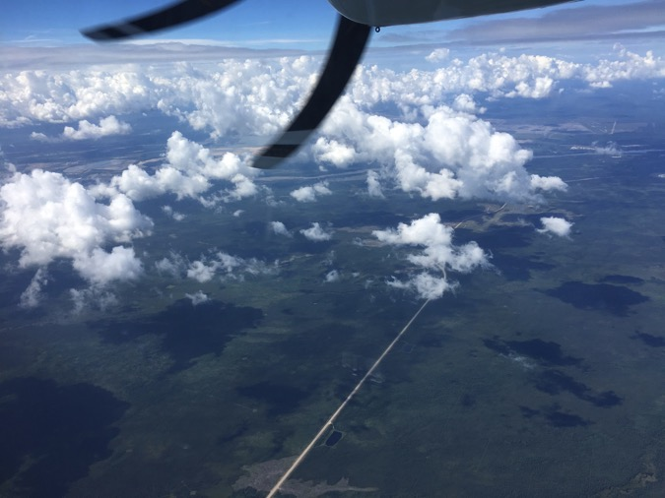
19 July 2017/DOY 200 Fort Smith – Fort McMurray – Saskatoon
Notes:
CFIS in-flight views

Slide 7
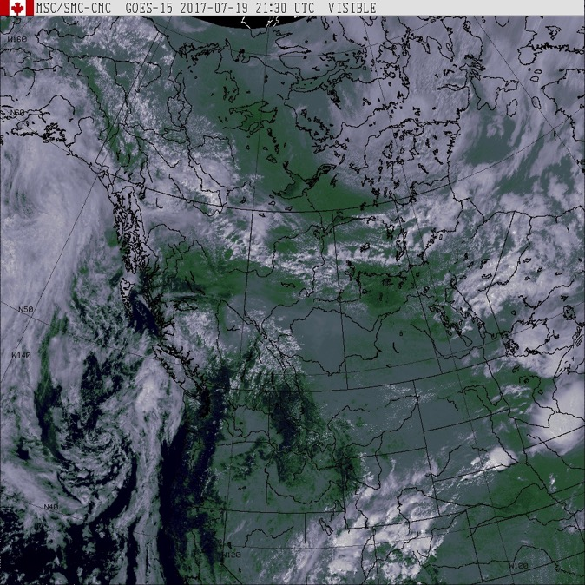
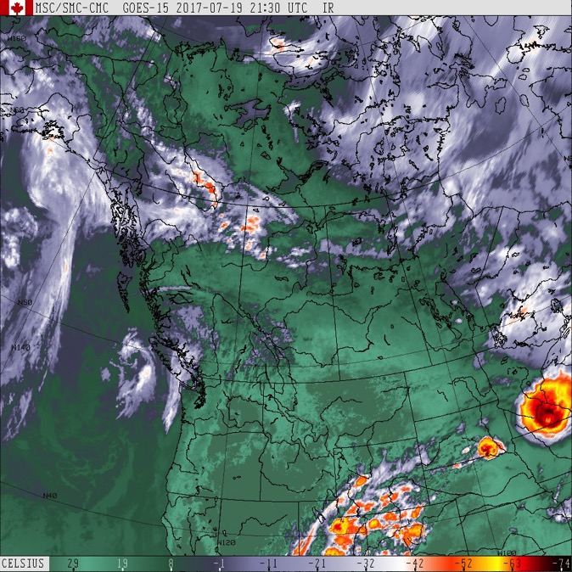
19 July 2017/DOY 200 Fort Smith – Fort McMurray – Saskatoon
GOES West IR
2130Z
GOES West Vis
2130Z
Partly cloudy to clear along the Fort Smith – Fort McMurray – Saskatoon transect

Slide 8
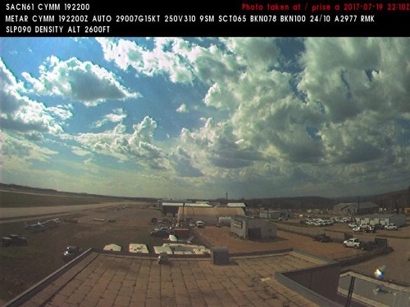
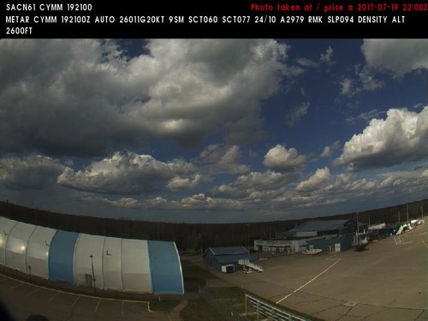
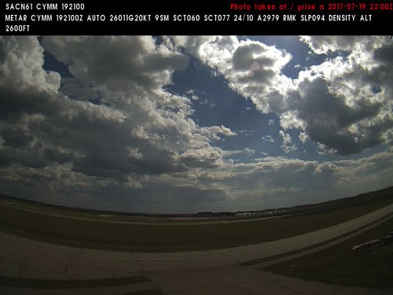
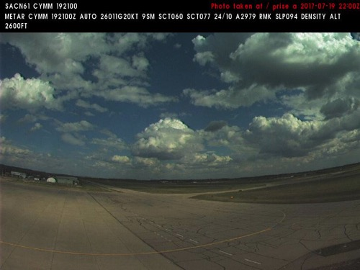
19 July 2017/DOY 200 Fort Smith – Fort McMurray – Saskatoon
Fort McMurray Airport (CYMM) N56 39 12 W111 13 24
NORTH
Northwest
Northeast
Southwest
Southeast
Notes:
NAVCAM sky pictures from the Fort McMurray Airport (CYMM) at 2200 UTC showing cloudy skies
See http://www.metcam.navcanada.ca/hb/index.jsp?lang=e for an interactive map of Canadian aviation cameras

Slide 9
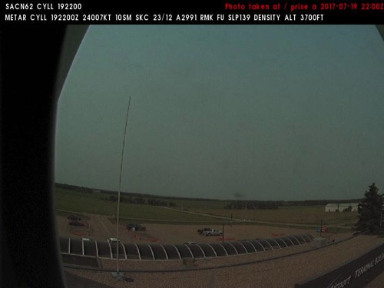
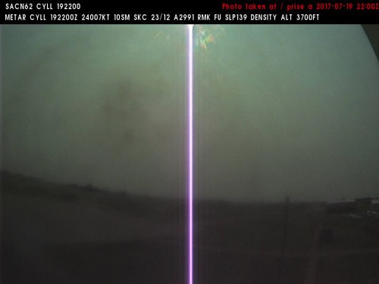
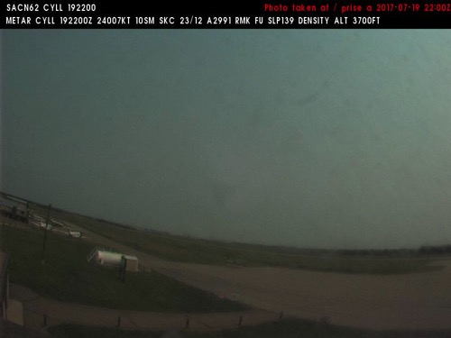
19 July 2017/DOY 200 Fort Smith – Fort McMurray – Saskatoon
Lloydminster Airport (CYLL) N53 18 33 W110 04 21
NORTH
Northwest
Northeast
West
Southeast
Notes:
NAVCAM sky pictures from the Lloydminster Airport (CYLL) at 2100 UTC showing haze/low clouds
See http://www.metcam.navcanada.ca/hb/index.jsp?lang=e for an interactive map of Canadian aviation cameras

Slide 10
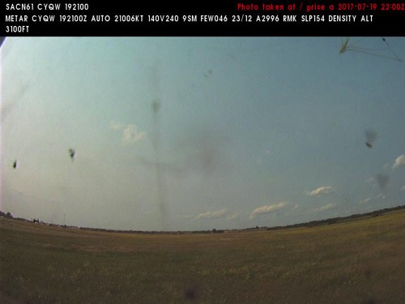
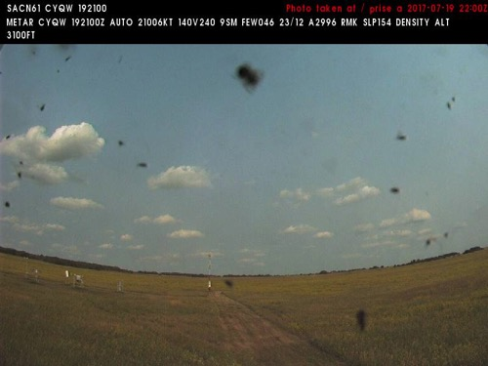
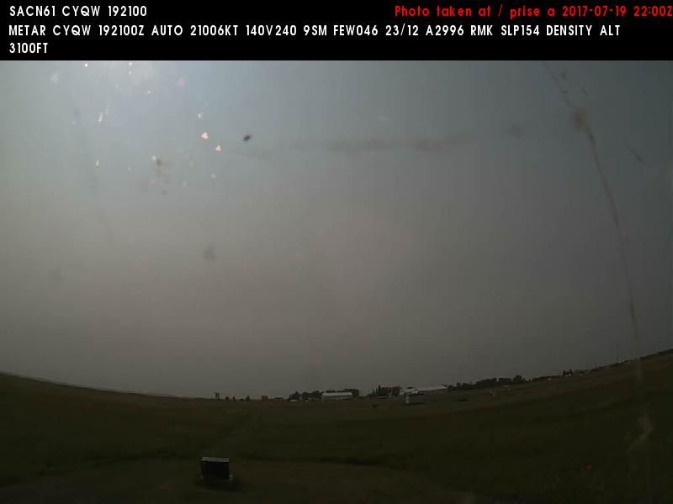
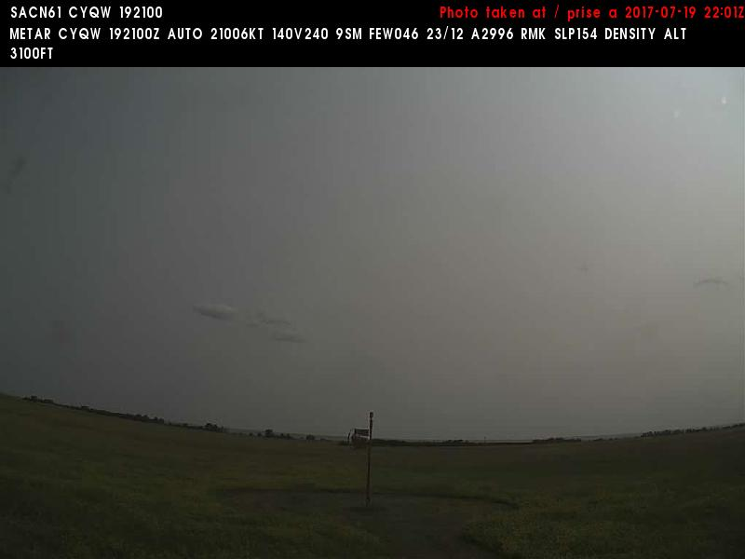
19 July 2017/DOY 200 Fort Smith – Fort McMurray – Saskatoon
North Battleford (CYQW) N52 46 09 W108 14 37
NORTH
North
East
West
South
Notes:
NAVCAM sky pictures from the North Battleford Airport (CYQW) at 2200 UTC showing mostly clear skies
See http://www.metcam.navcanada.ca/hb/index.jsp?lang=e for an interactive map of Canadian aviation cameras

Slide 11
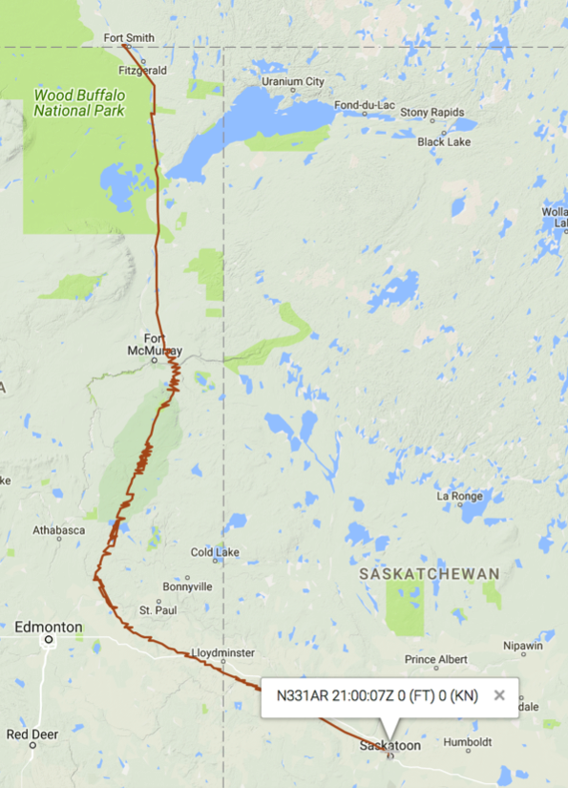
19 July 2017/DOY 200 Fort Smith – Fort McMurray – Saskatoon
As-flown lines
Notes:
2x rosettes flown over Scotty Creek flux towers

Slide 12
19 July 2017/DOY 200 Fort Smith – Fort McMurray – Saskatoon
CFIS Quick-look products – to be delivered
Notes:
These 3 lines cover NGEE-Arctic SewPen field sites
Note the rugged terrain and fluvial tracings of the vegetation

Slide 13
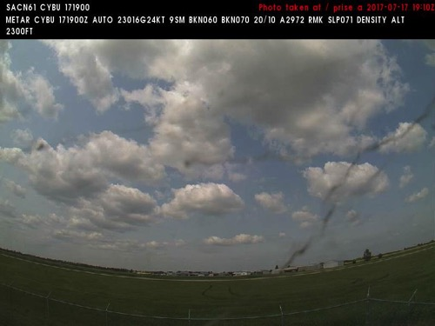
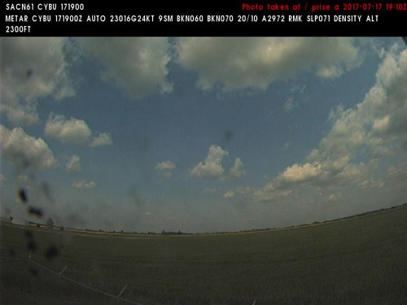
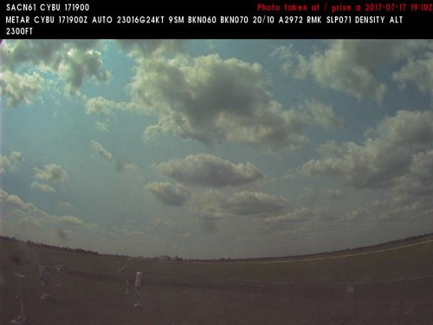
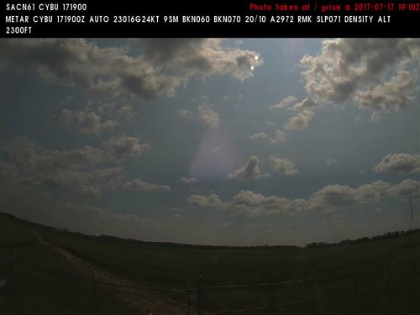
19 July 2017/DOY 200 Fort Smith – Fort McMurray – Saskatoon
Nipawin (CYBU) N53 19 59 W104 00 14
NORTH
Northwest
North
West
Southeast
Notes:
NAVCAM sky pictures from the Nipawin Airport at 1910 UTC showing partly to mostly cloudy skies
See http://www.metcam.navcanada.ca/hb/index.jsp?lang=e for an interactive map of Canadian aviation cameras

